Slide 1

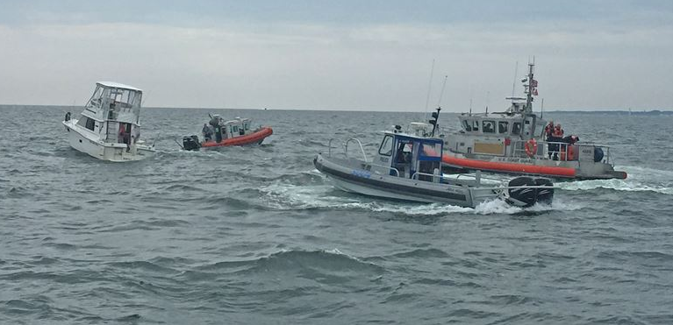
Recreational Boating Accidents:
Prevention Through Awareness
Zijia Liu , Ralph Parlin, Yixiong Zheng

Slide 2
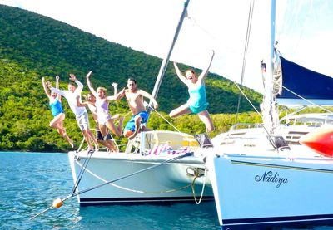
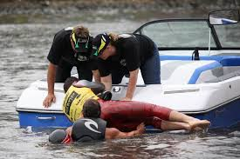
The Two Sides of Boating
Recreational boating is one of America’s favorite pastimes
Annual economic impact of recreational boating averages around $170.3 billion a year
Supports more that 691,149 workers and 35,277 business
~141.6 million Americans go boating each year
2018 there were over 5700 boating accidents on US waters
Resulting in:
$46 million worth of damages
Over 680 deaths
Over 2,500 serious injuries

Slide 3
Recreational Boating Accidents
Purpose & Agenda
Purpose
This brief is to offer a quick overview of our team’s journey from data acquisition to poster development which visualized recreational boating accident data from 2017 and 2018.
Agenda
Road to poster development
Poster Taxonomy
Key Visualization
Supporting Visualization
Closing

Slide 4
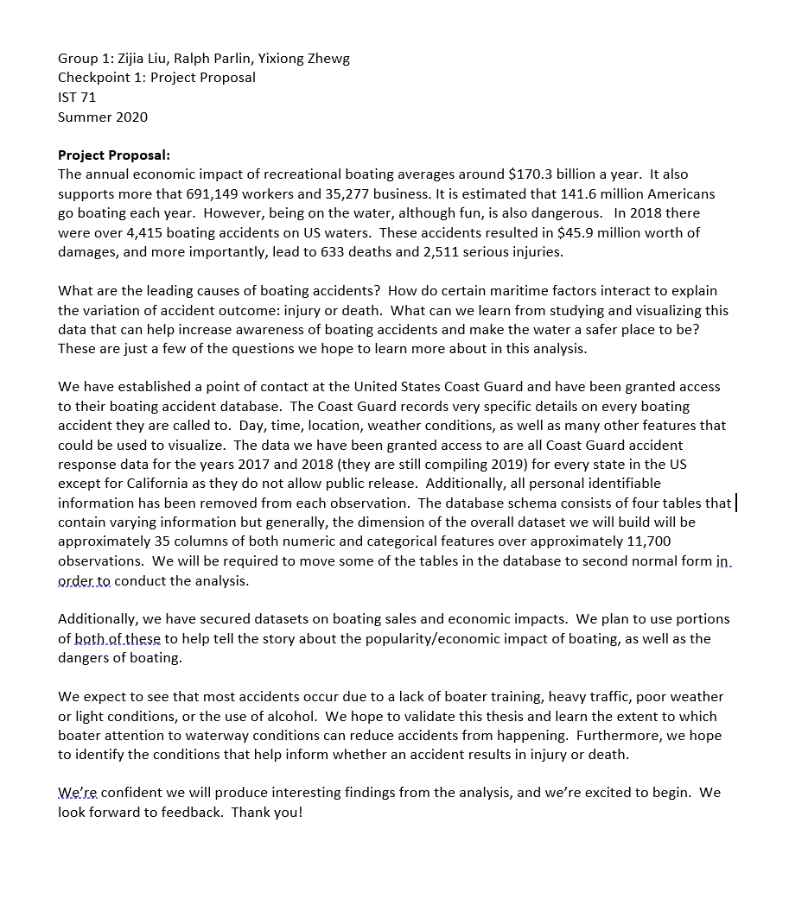
Recreational Boating Accidents
Road to Poster Development
Checkpoint 1
Proposal
Checkpoint 2
Dataset:
Provided by U.S. Coast Guard; Access Database file for years 2017 and 2018; multiple tables; all states except California
Queried, normalized and exported to csv
11,865 observations; 36 features
Cleaned, wrangled and organized data in R; approximately 1000 lines of code
Hypothesis: We expected to see that most accidents occur due to a lack of operator experience, heavy traffic, poor weather or light conditions, or the use of alcohol.
We hoped to validate this thesis and learn the extent to which boater attention to waterway conditions can reduce accidents from happening.
Audience: All boaters or people that are enjoy U.S. waterways. One impact that COVID-19 had on the 2020 boating season is that demand is at an all time high for boats. Boat brokers across the country are reporting record numbers, and some manufacturers are struggling to keep up. This means there is a surge in new boaters which means the water has become more dangerous with an increase of inexperienced boaters.
Research Questions:
What are the boating accident outcomes and how many are there?
What happened?
What was the cause?
Notes:
Checkpoint 1: Proposal
Checkpoint 2:
Layout Plan
Color: Prove that your colors have a natural relationship (show the color wheel). Explain how your color selection supports the general feel you want the user to have.

Slide 5
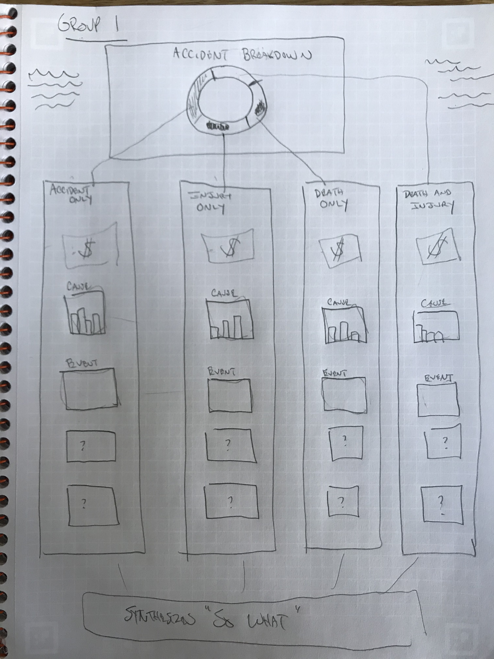
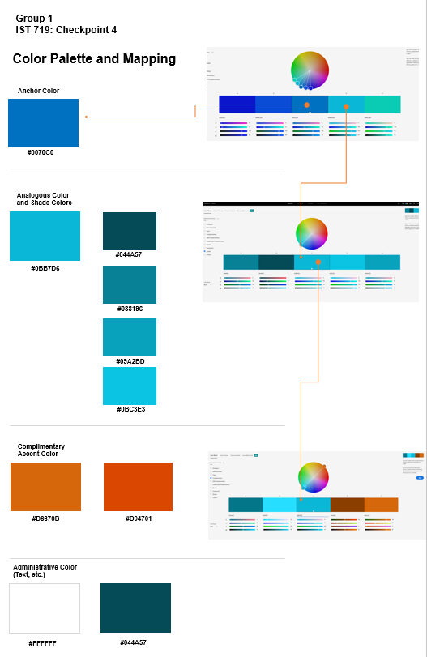
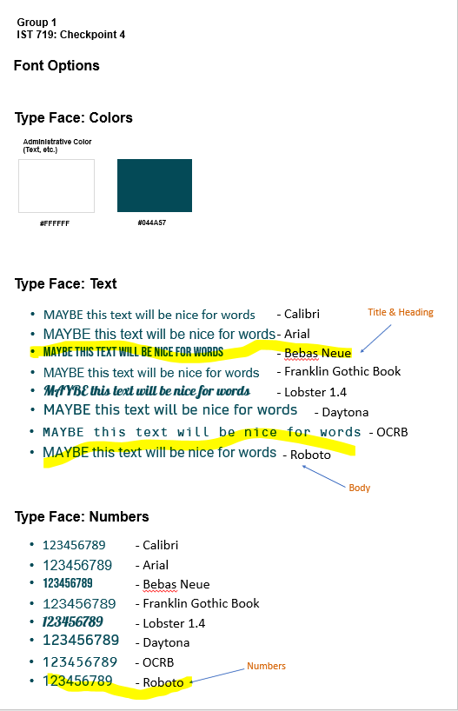
Recreational Boating Accidents
Road to Poster Development
Checkpoint 3
Ideation
Checkpoint 4
Business Rules (data) / Branding Guidelines
Notes:
Checkpoint 1: Proposal
Checkpoint 2:
Layout Plan
Color: Prove that your colors have a natural relationship (show the color wheel). Explain how your color selection supports the general feel you want the user to have.

Slide 6
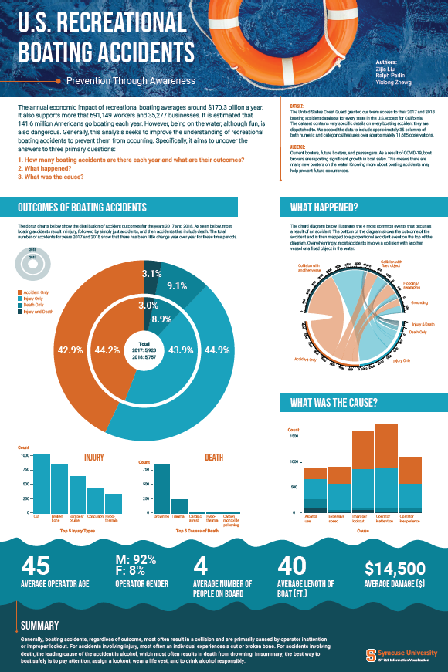
Recreational Boating Accidents
Poster Taxonomy
24 x 35 Artboard
CMYK color space (built for print)
Title/Author Section
Story and primary research questions
Data and Audience
Supporting Visualization: Research Question 2
(Chord Diagram)
Key Visualization: Research Question 1
(Dual Donut with
Bar breakouts)
Supporting Visualization: Research Question 3
(Stacked Bar)
Complimentary Summary Stats
Summary Findings
Notes:
Data Encoding: Explain your data encoding plan.
Key visualization: Describe plan for the main plot. Must be 2 or more dimensions showing a relationship that answers one of your questions.
Supporting Visualization(s): Describe plan for one or two additional multi dimension visualizations that answer your other questions. Explain use of data encoding.
Color: Prove that your colors have a natural relationship (show the color wheel). Explain how your color selection supports the general feel you want the user to have.
Layout and use of space: Describe your layout plan and techniques you plan to use to guide the user through your poster.
Draft: Present preliminary plots and graphs you have so far
WOW Factor: Explain how you plan to achieve the WOW factor

Slide 7
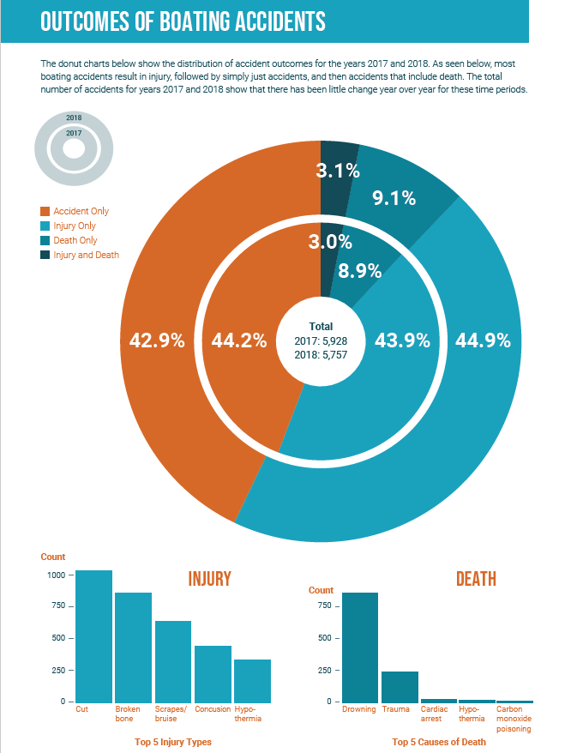
Recreational Boating Accidents
Outcomes of Boating Accidents
Dual donut show 2 years accidents
Proportion almost same in 2 years
Most only accident and injury

Slide 8
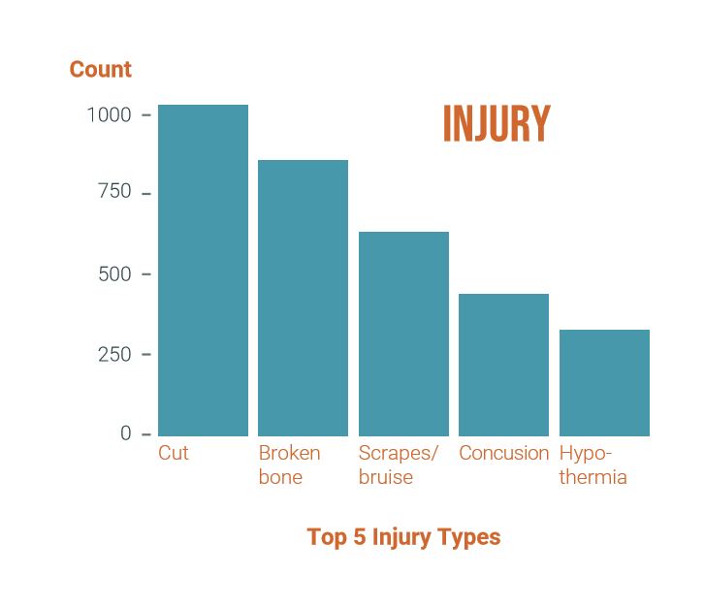
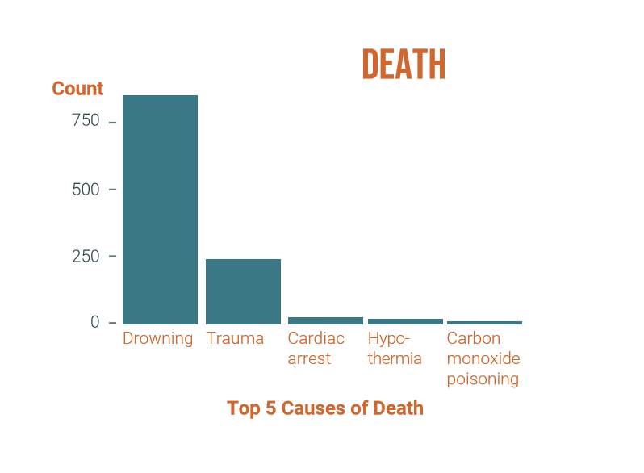
Recreational Boating Accidents
Cause of injury and death
2 bar plots show the distribution of injury and death cause
Many injury appears with not big counts difference
About ¾ are drowning, and ¼ are trauma
Other cause take little proportion

Slide 9
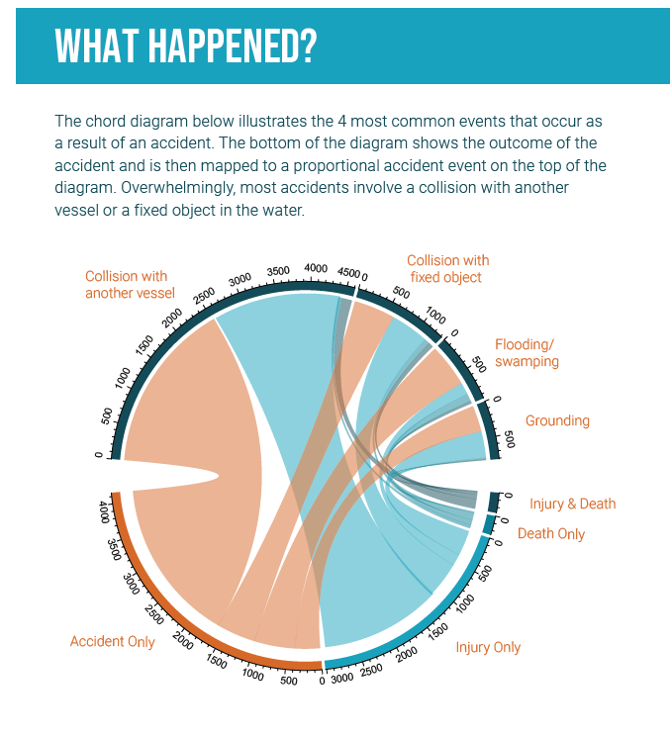
Recreational Boating Accidents
Data Summary
Chord Diagram: represents the relationship between entities. It is composed of node segments and arc-shaped edges.
Four outcomes:
Accident Only
Injury Only;
Death Only;
Injury & Death.
Four most common events results of an accident:
Collision with another vessel;
Collision with fixed object;
Flooding/Swamping
Grounding

Slide 10
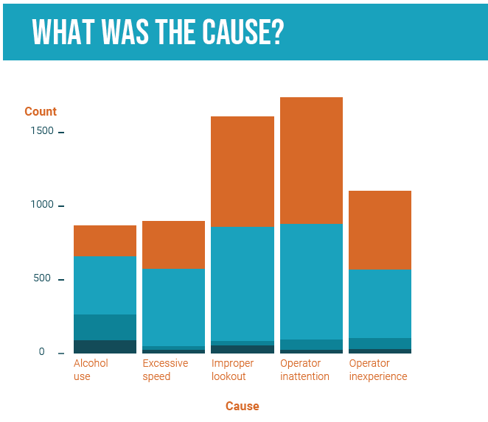
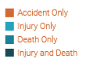
Recreational Boating Accidents
Data Summary
Top FIVE accident causes:
Alcohol Use;
Excessive Speed;
Improper lookout;
Operator inattention;
Operator inexperience.
Most accidents are caused by human factors. Careful operation can greatly reduce the occurrence of accidents.

Slide 11

Recreational Boating Accidents
Closing
Generally, boating accidents, regardless of outcome, most often result in a collision and are primarily caused by operator inattention or improper lookout.
For accidents involving injury, most often an individual experiences a cut or broken bone.
For accidents involving death, the leading cause of the accident is alcohol, which most often results in death from drowning.
In summary, the best way to boat safely is to pay attention, assign a lookout, wear a life vest, and to drink alcohol responsibly.

Slide 12
Recreational Boating Accidents
Thank you, be safe on the water, and always wear a life jacket!

